Slide 1
Web Browsers

Slide 2



Web Browsers
Allow the user to access the world wide web!
Firefox’s logo
Google Chrome’s logo
Internet Explorer’s logo

Slide 3
Web Browsers
Cache
Stored data from previously visited websites
Helps webpages load faster
Cache can be cleared/erased
Client-side scripting
Scripts that run in a browser (not the web server)
Saves on network traffic
Can be disabled

Slide 4


Web Browsers
Add-ons
Also known as extensions
Allows the browser to do more
Example: Ad blockers
Private Browsing
Does not track user’s data in the browser
Network traffic can still be monitored
A husband might use this if buying a gift for his wife
Adblock Plus’s logo

Slide 5
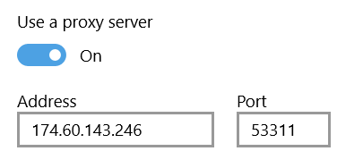
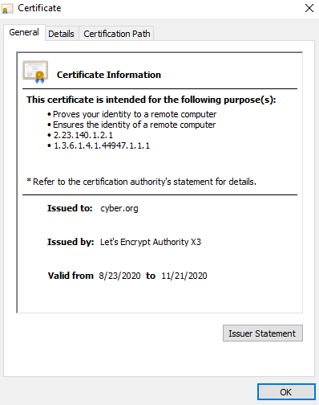
Web Browsers
Proxies
Network traffic routed through them
Schools use them to stop kids from accessing certain content
Certificates
3rd Parties verifying they trust a website
Valid certificate means the site is trusted
Invalid certificate means the site has not been verified

Slide 6
Web Browsers
Blockers
Pop-up blockers block annoying pop-ups
Script blockers block scripts from running
Browser Compatibility
A good website/application will be able to work on all web browsers
Some websites/applications can not be ran on every web browser

